Slide 1
INTRODUCTION TO
ALGORITHMS
FOURTH EDITION

Slide 2
LECTURE NOTES FOR CHAPTER 22
Single-Source Shortest Paths

Slide 3
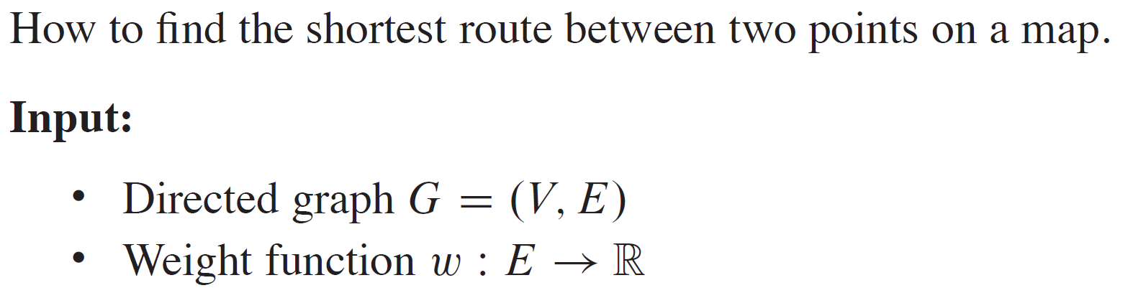
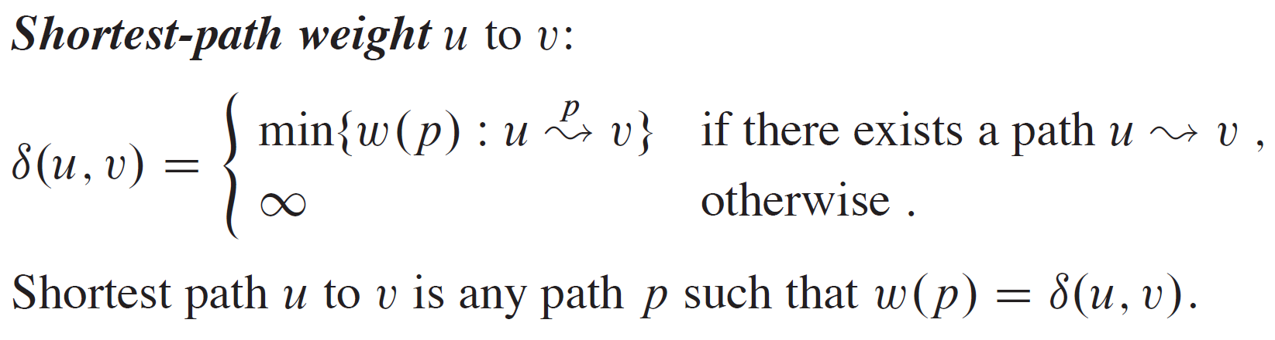
SHORTEST PATHS

Slide 4
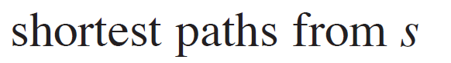
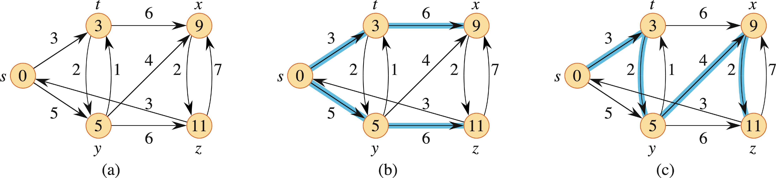
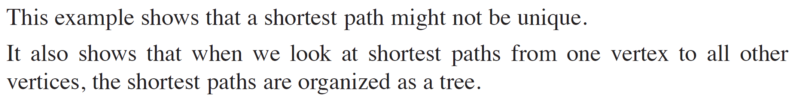
EXAMPLE

Slide 5
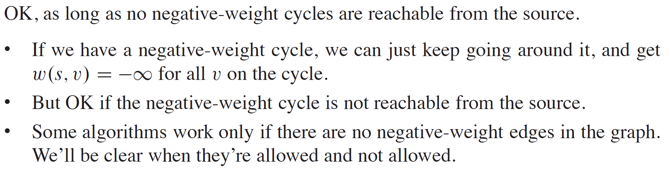
NEGATIVE-WEIGHT EDGES

Slide 6
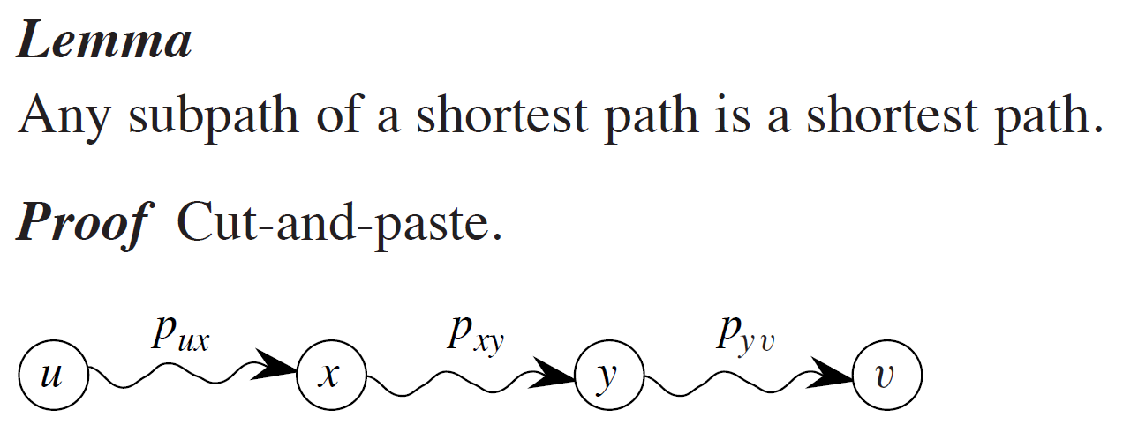
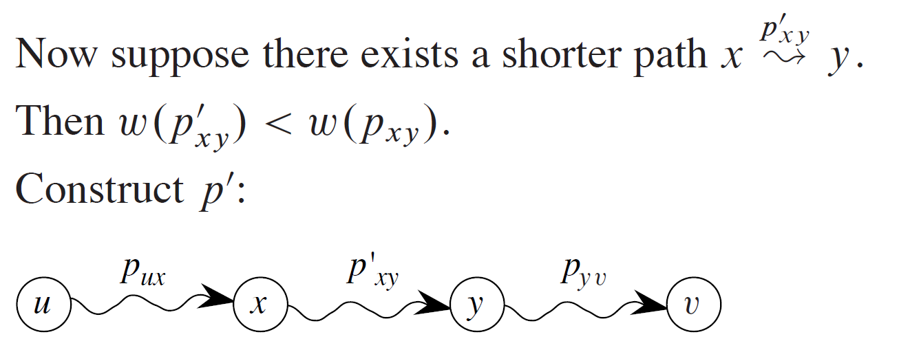
OPTIMAL SUBSTRUCTURE

Slide 7
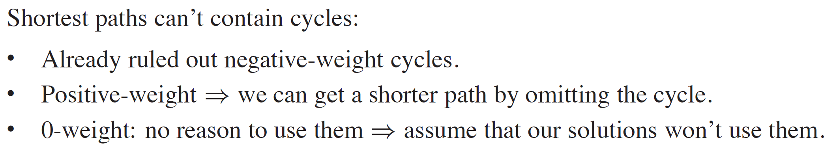
CYCLES

Slide 8
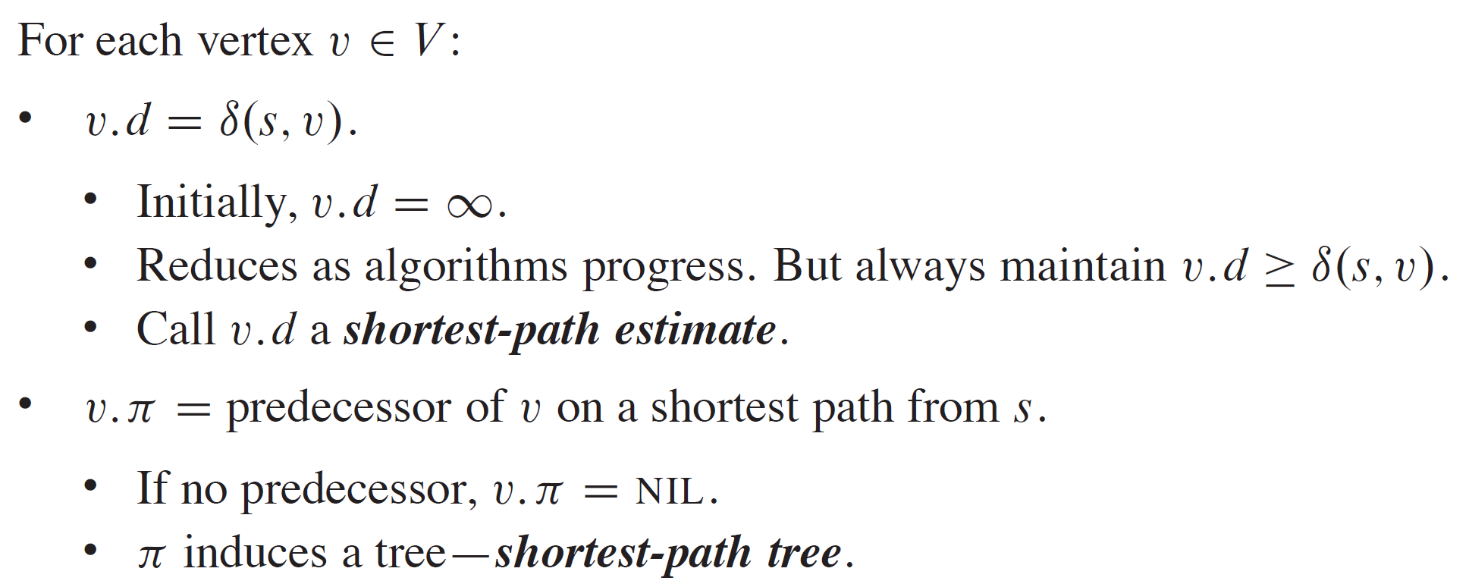
OUTPUT OF SINGLE-SOURCE SHORTEST-PATH ALGORITHM

Slide 9
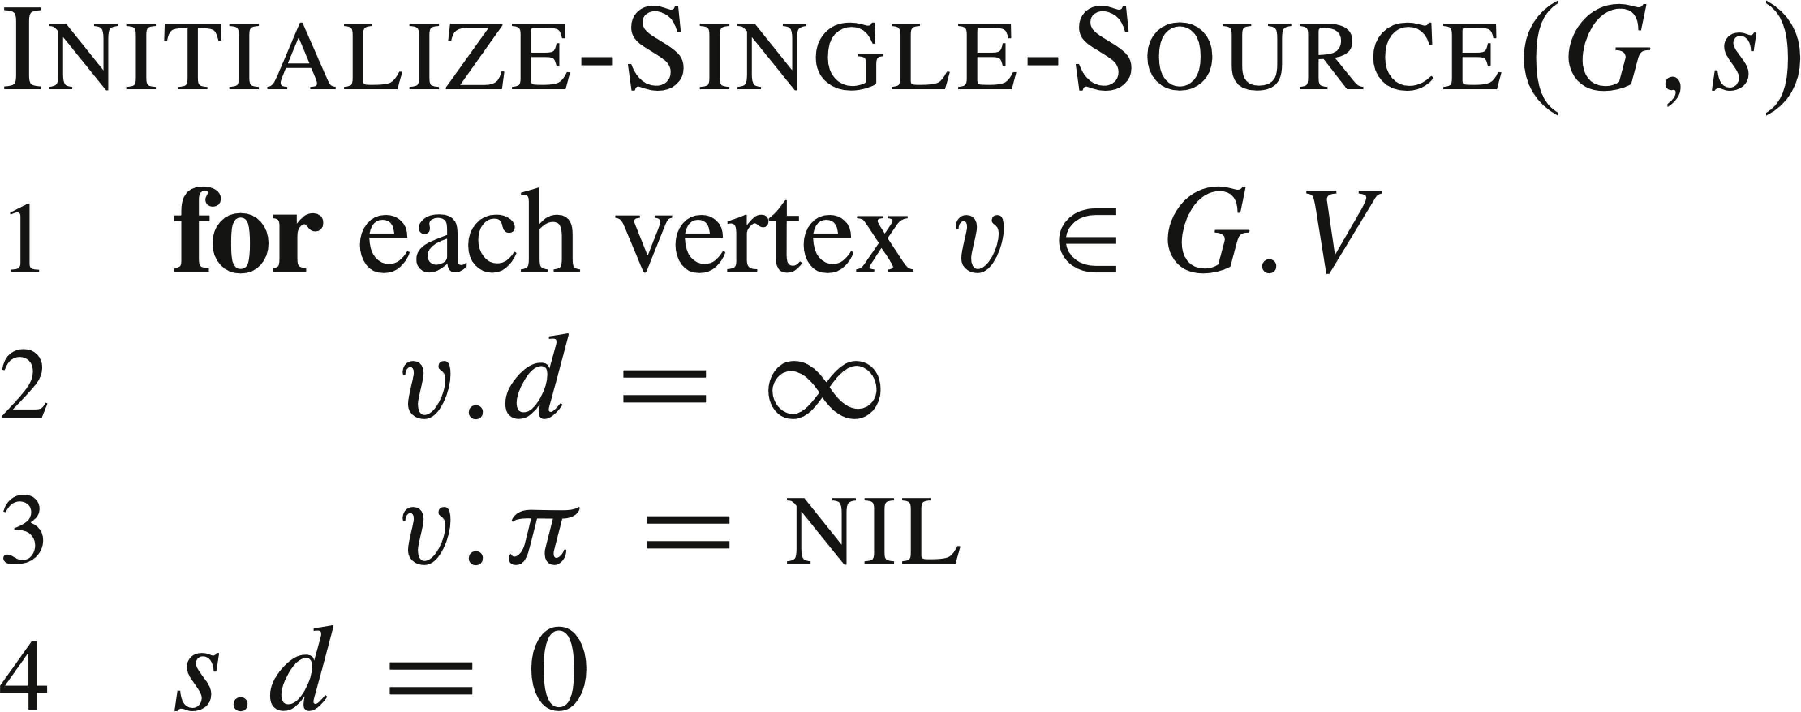
INITIALIZATION

Slide 10
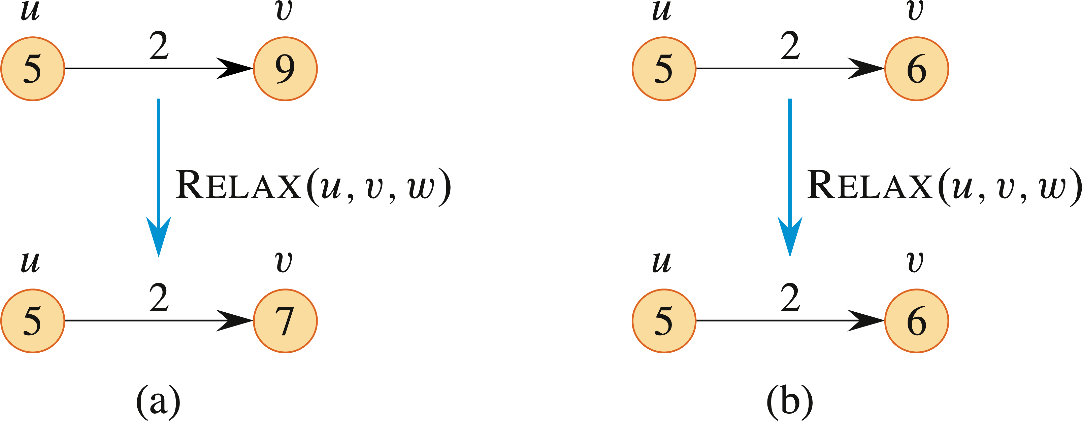
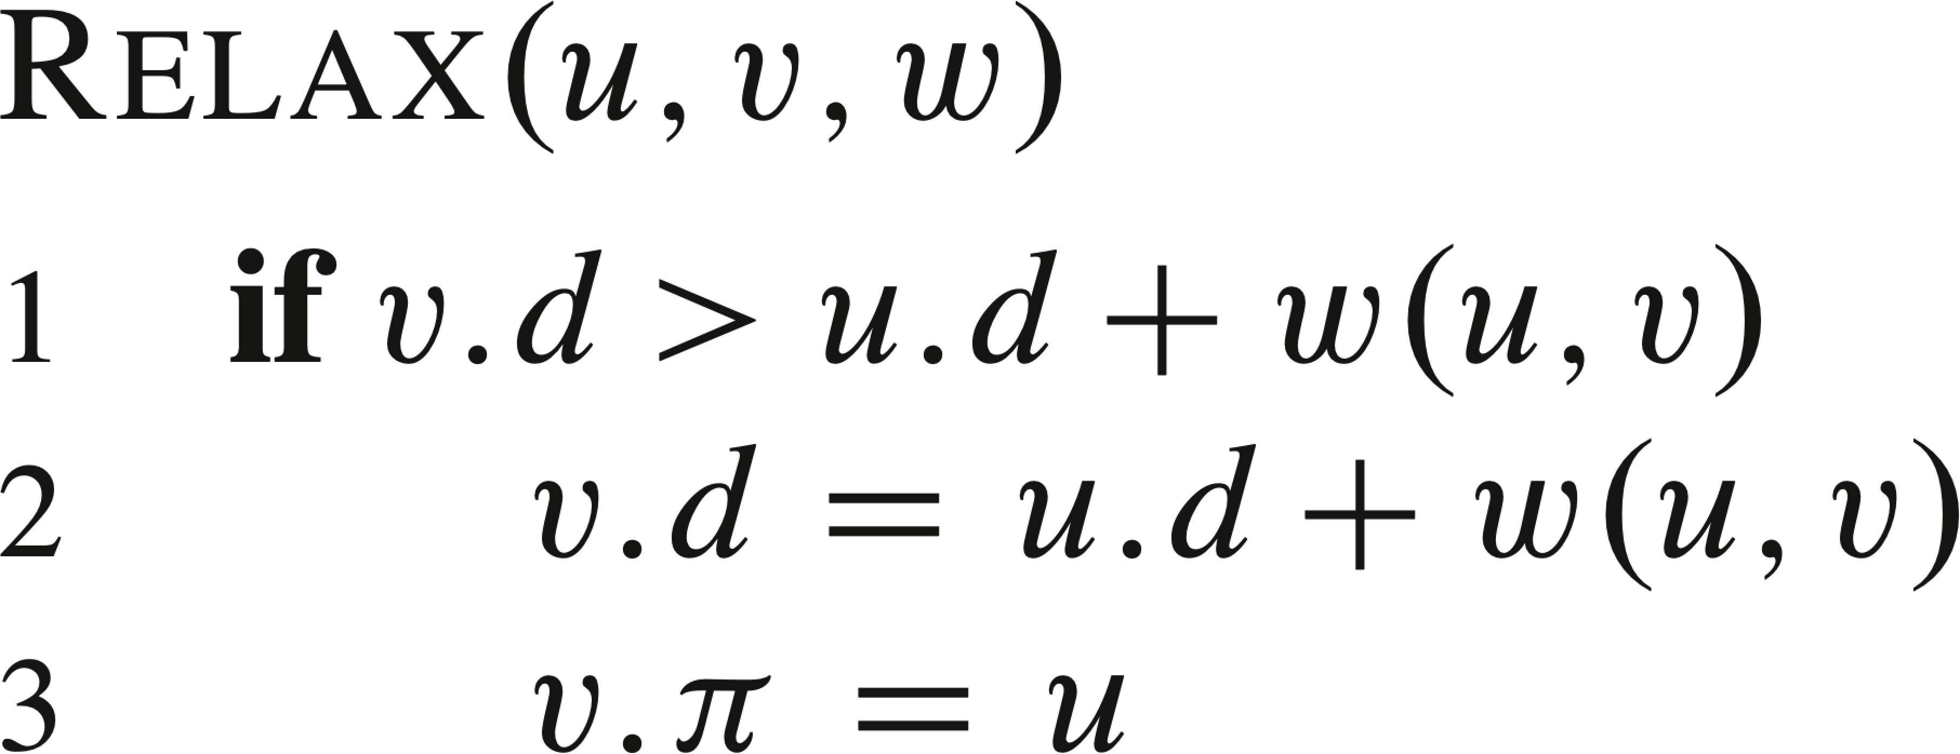
RELAXING AN EDGE (u,v)

Slide 11
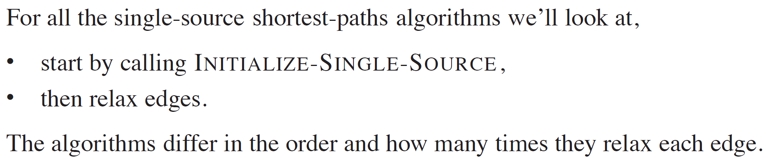
RELAXING AN EDGE (continued)

Slide 12
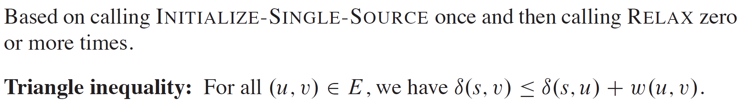
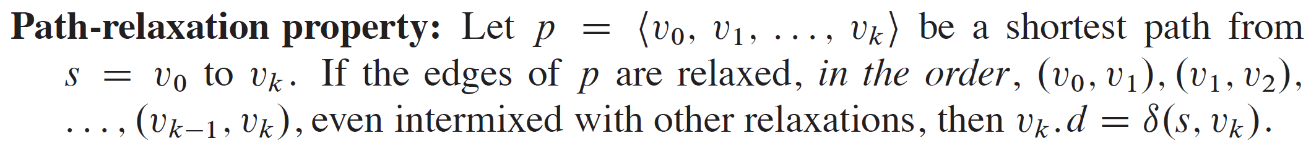
SHORTEST-PATHS PROPERTIES

Slide 13
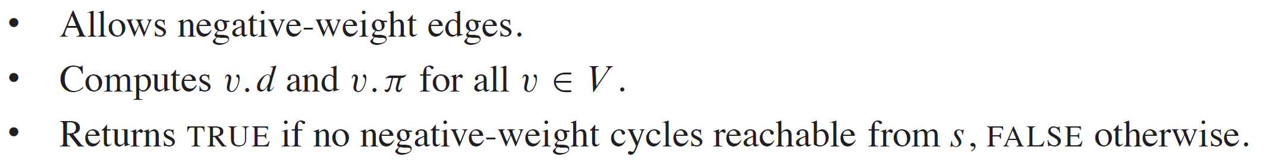
THE BELLMAN-FORD ALGORITHM

Slide 14
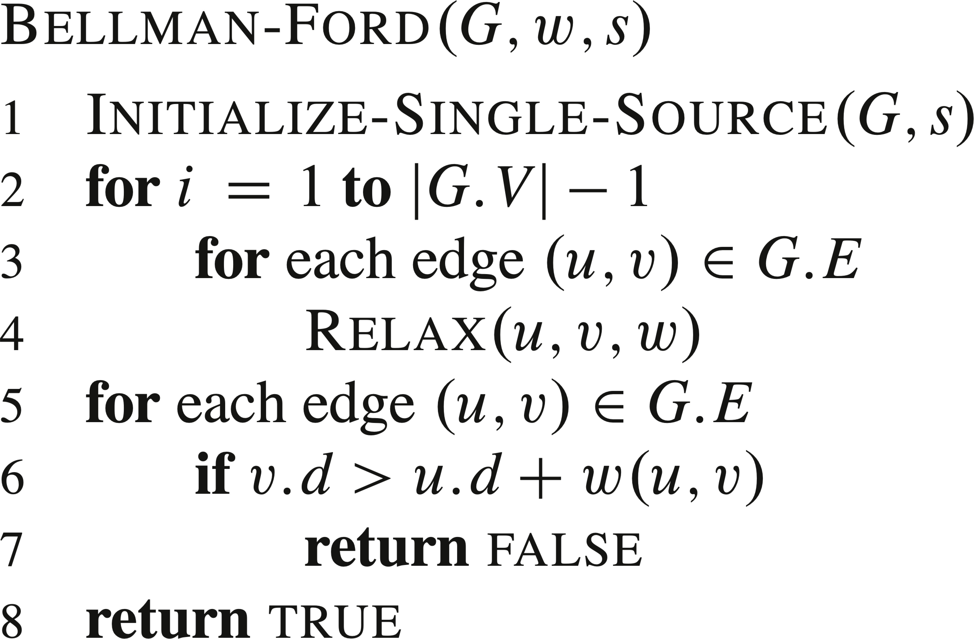
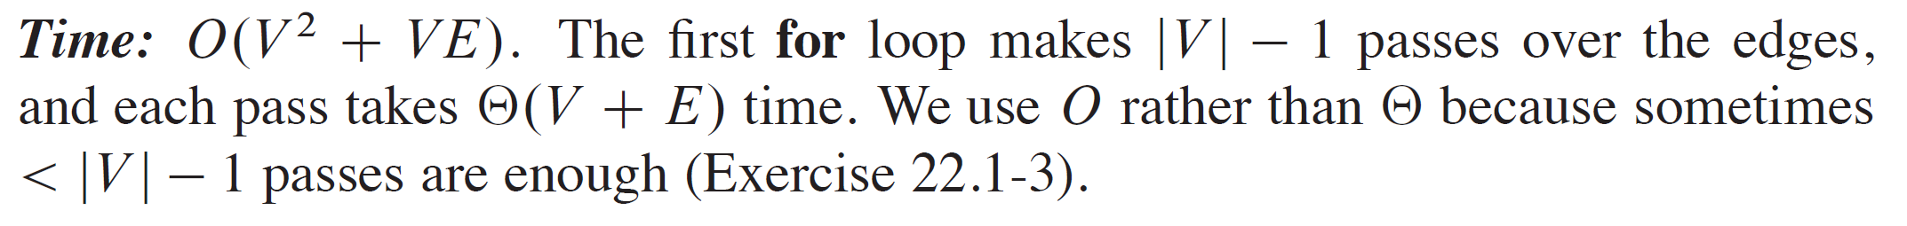
THE BELLMAN-FORD ALGORITHM (continued)

Slide 15
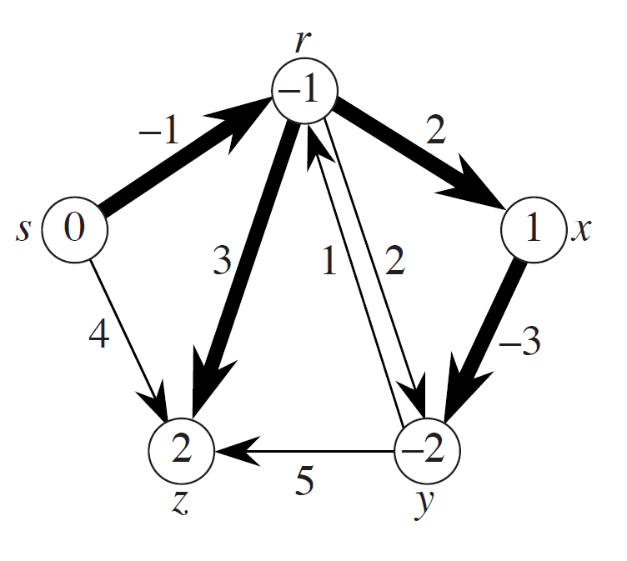
EXAMPLE

Slide 16
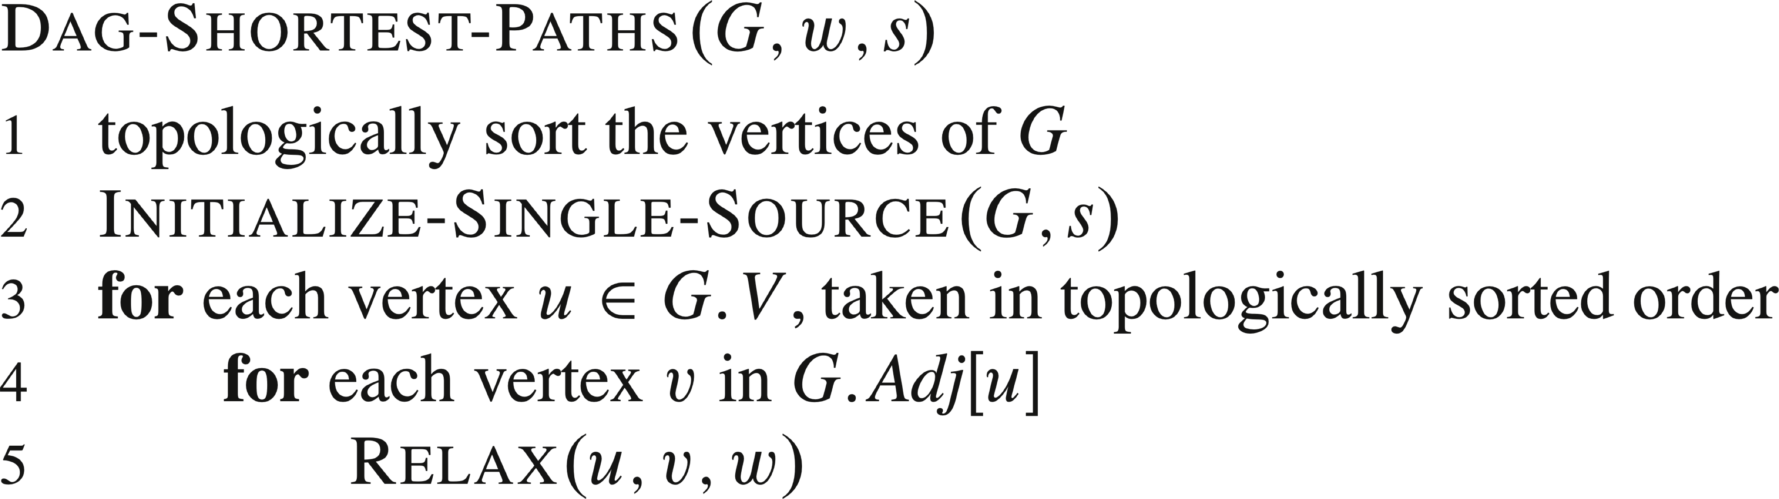
SINGLE-SOURCE SHORTEST PATHS IN A DIRECTED ACYCLIC GRAPH
Since a dag, we’re guaranteed no negative-weight cycles.

Slide 17
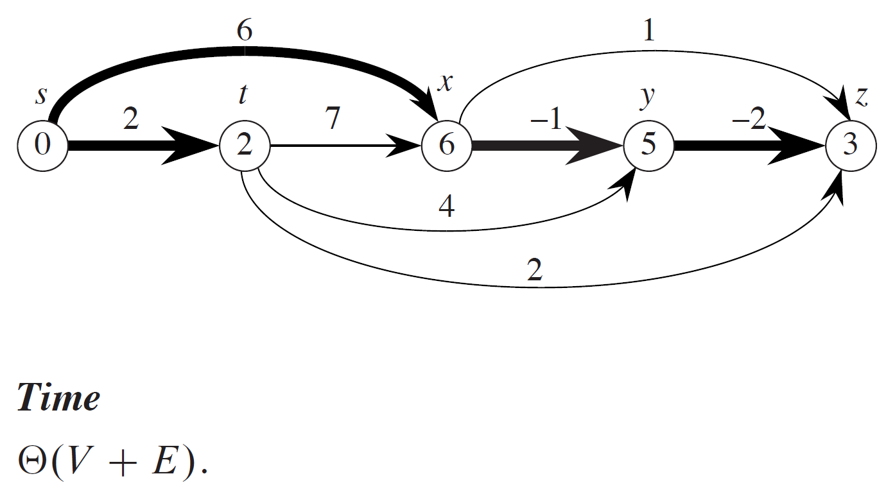
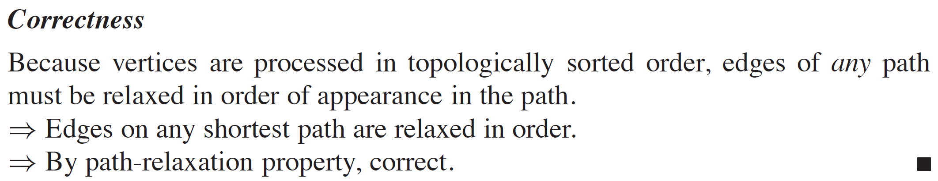
EXAMPLE

Slide 18
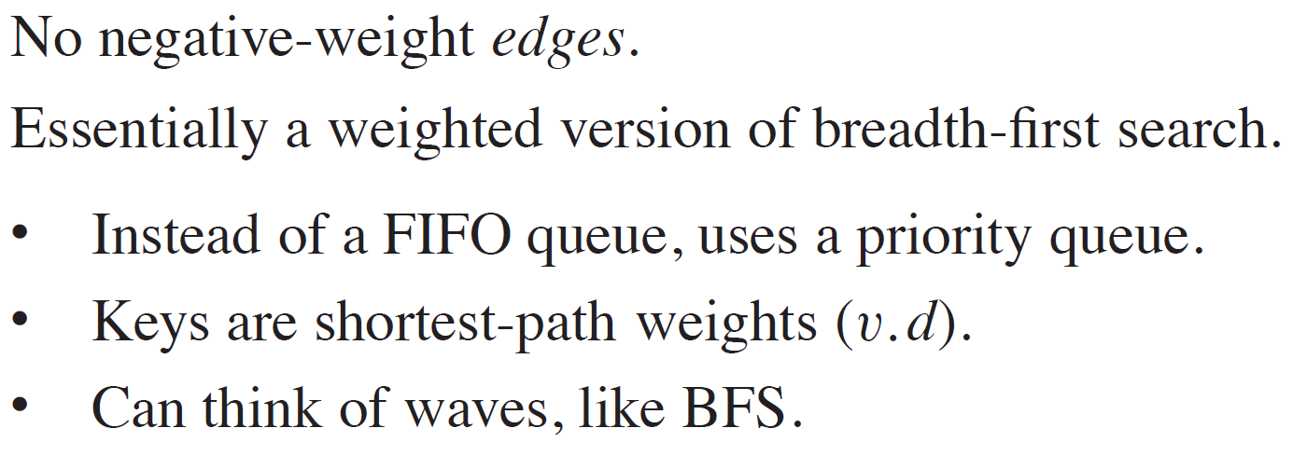
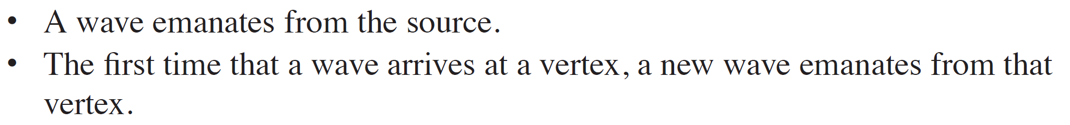
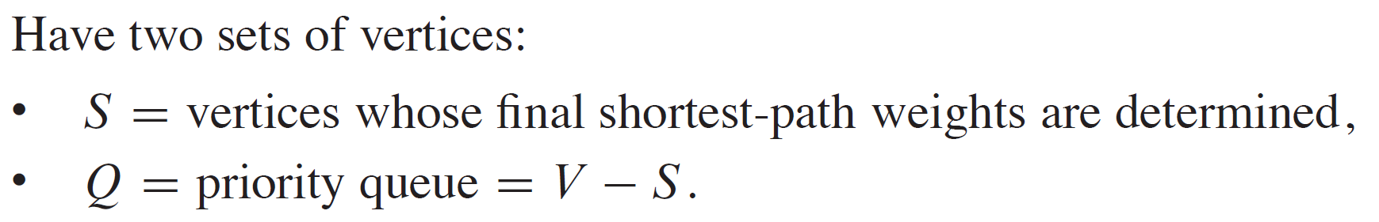
DIJKSTRA’S ALGORITHM

Slide 19
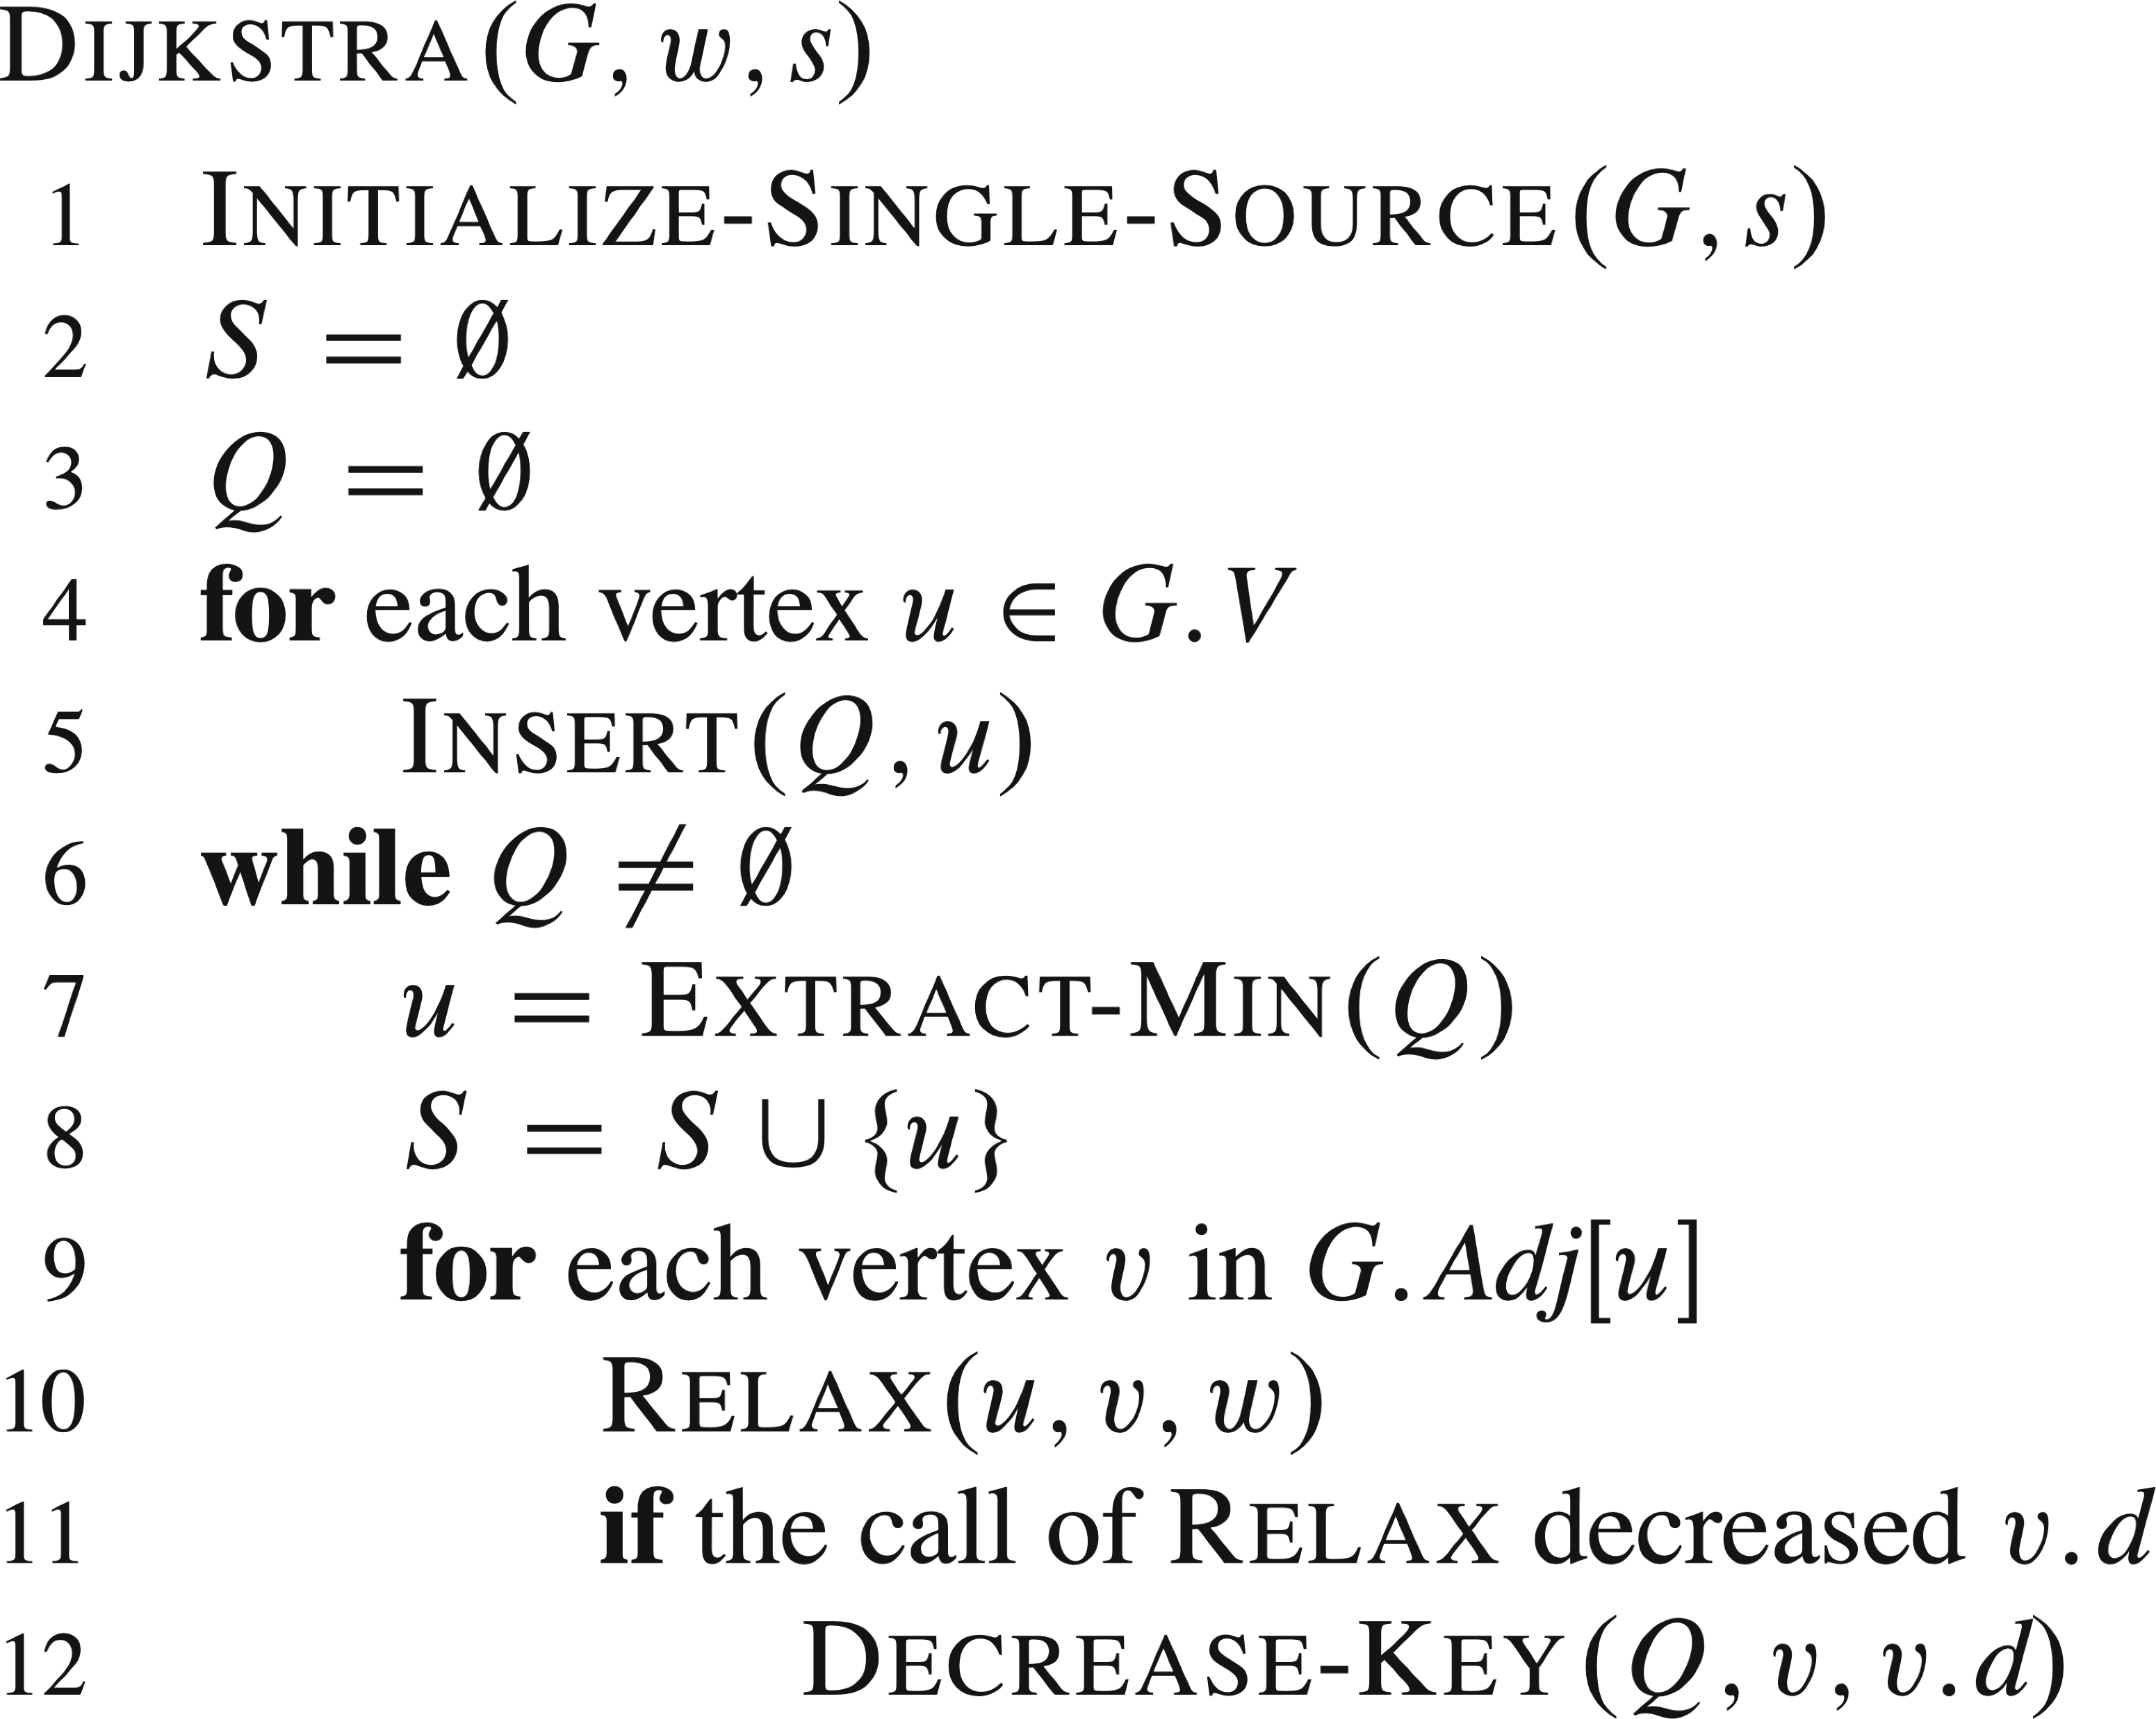
DIJKSTRA’S ALGORITHM (continued)

Slide 20
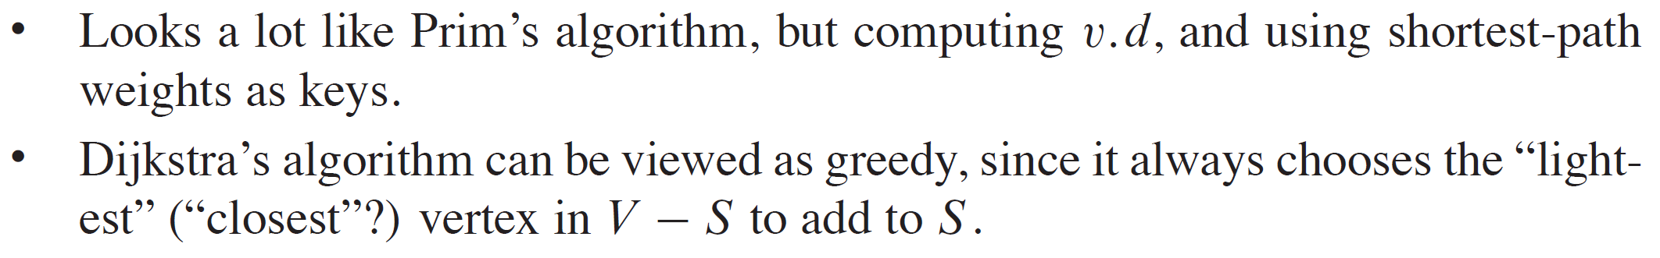
DIJKSTRA’S ALGORITHM (continued)

Slide 21
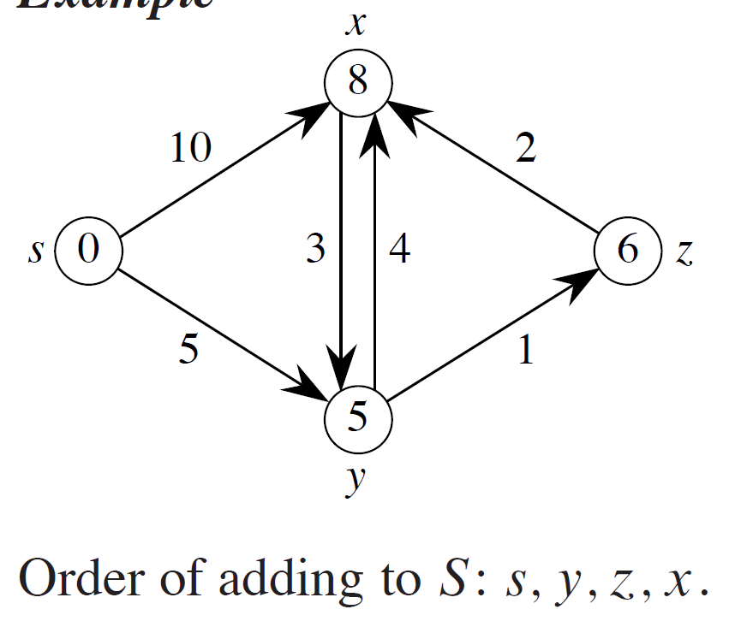
EXAMPLE
Correctness
The algorithm extracts vertices from the heap in order of shortest distance from the source. Inductively, if the algorithm has found the shortest paths to some set S, the shortest path to the closest vertex in V-S can be found by appending a single edge to a path to some vertex in S.

Slide 22
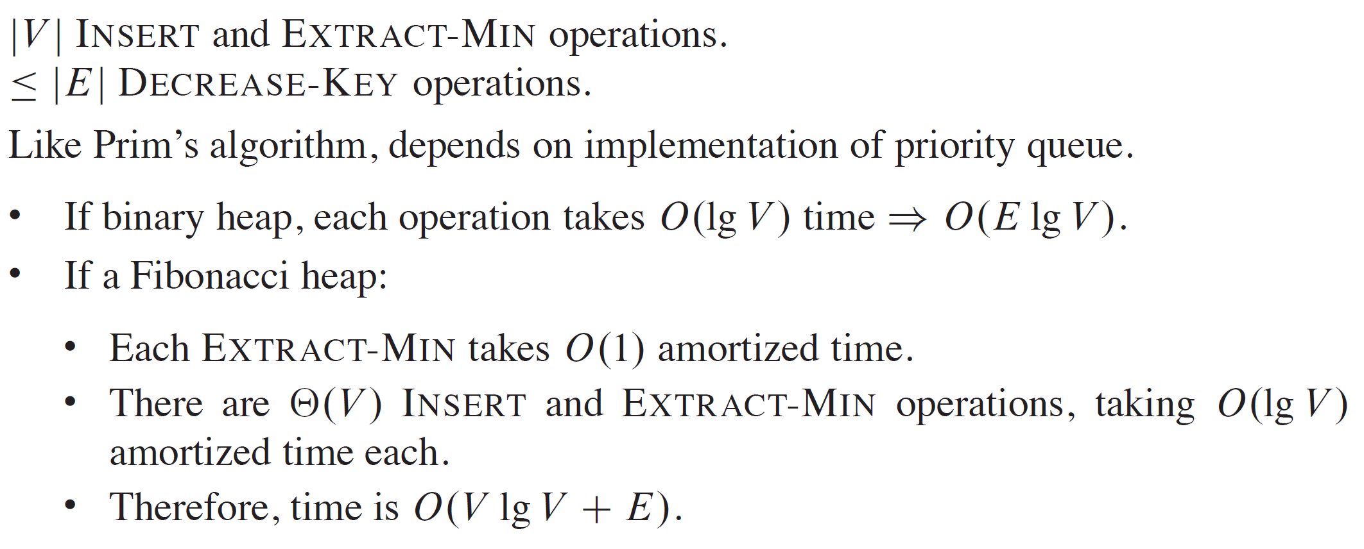
ANALYSIS

Slide 23
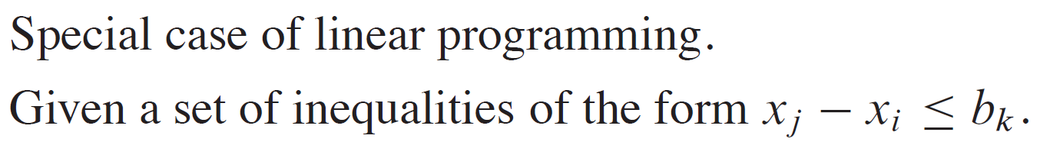
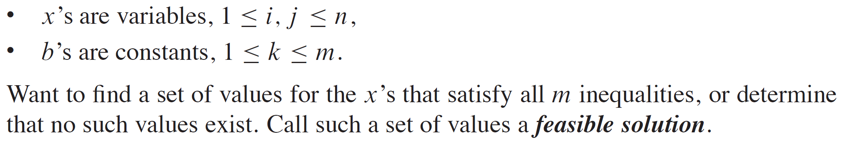
DIFFERENCE CONSTRAINTS

Slide 24
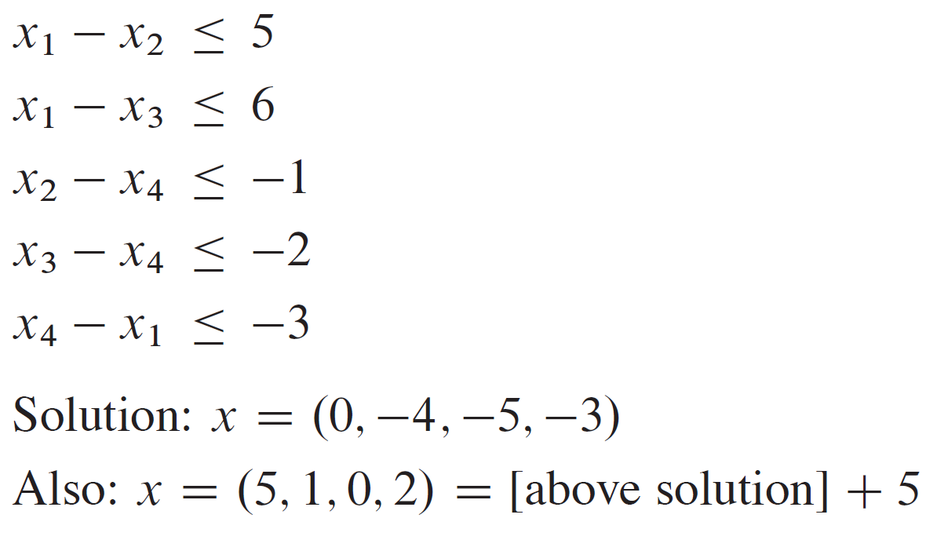
EXAMPLE

Slide 25
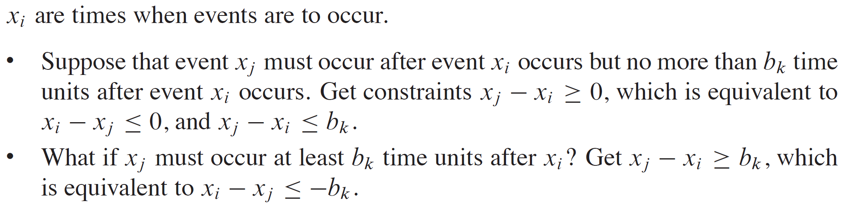
EXAMPLE APPLICATION

Slide 26
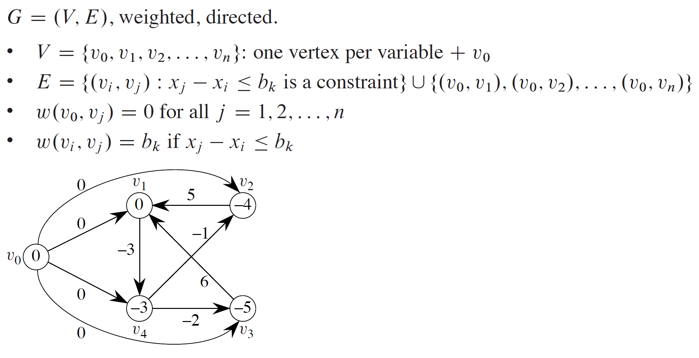
CONSTRAINT GRAPH

Slide 27
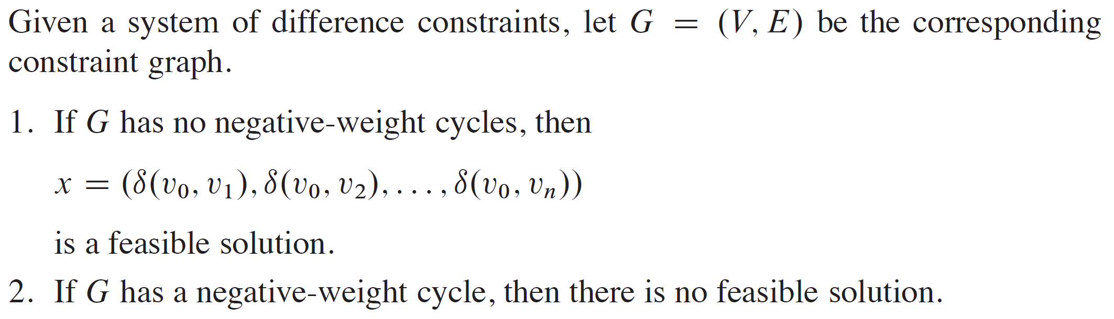
THEOREM

Slide 28
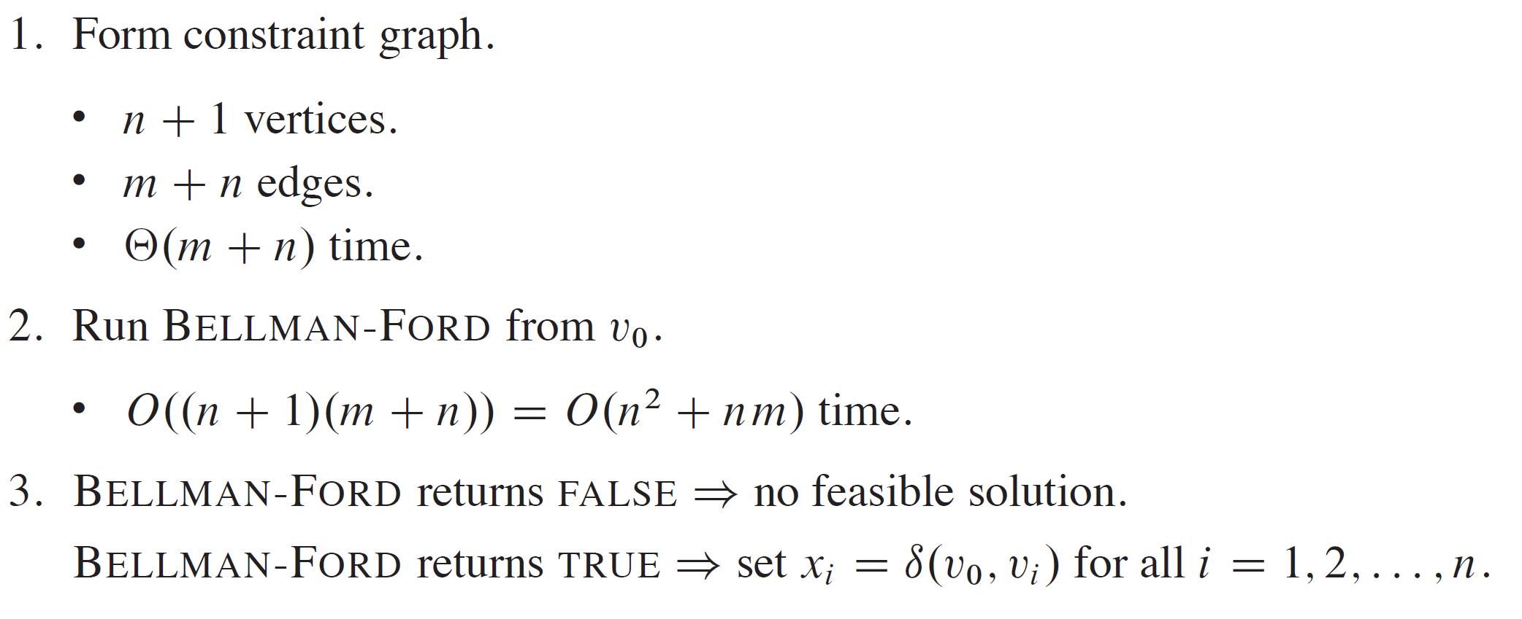
HOW TO FIND A FEASIBLE SOLUTION

